Slide 1

The Battle of the Neighborhoods IBM Applied Data Science Capstone
I.Lahlou
May 2020

Slide 2
Table of contents
Introduction: Business Problem
Data
Methodology
Analysis
Results and Discussion
Conclusion

Slide 3
Introduction: Business Problem
An entrepreneur is looking for an ideal location to target for a new Ice Cream Shop in an area within Fairfax County, Virginia.
He wants to use a quantitative approach to identify the 3 best locations within the target search area. He will then pick his preferred location from these 3 identified locations.
His selection criteria include:
Low Ice Cream Shops per capita
Located in a commercial area
High foot traffic

Slide 4
Data
This problem can be solved using:
The most recent population data from Fairfax County
Land-use data from Fairfax County to identify commercial areas
Venue data from the Foursquare location data
Once the data is collected, processed and explored, an in-depth analysis will be performed, and conclusions will be drawn. The results will then be communicated to the entrepreneur for feedback.

Slide 5
Methodology
The search area targeted by the entrepreneur includes just a small section within the county. A polygon representing this area will therefore be created to filter only the population within the target search area.
The target area polygon will then be divided into a grid of equal sized clusters representing sub-neighborhoods.
The population count sum of each sub-neighborhood will then be computed and assigned to the cluster's centroid location.
Venue data will be extracted from the Foursquare location data, reviewed and structured.
Land use data will then be filtered and mapped to display only commercial areas within the target search area.
A selection will be made by process of elimination. We will eliminate clusters without commercial areas, then clusters with high Ice Cream shops per capita and finally we will select the best 3 locations out of the remaining clusters based on general knowledge of the foot traffic in those clusters.

Slide 6
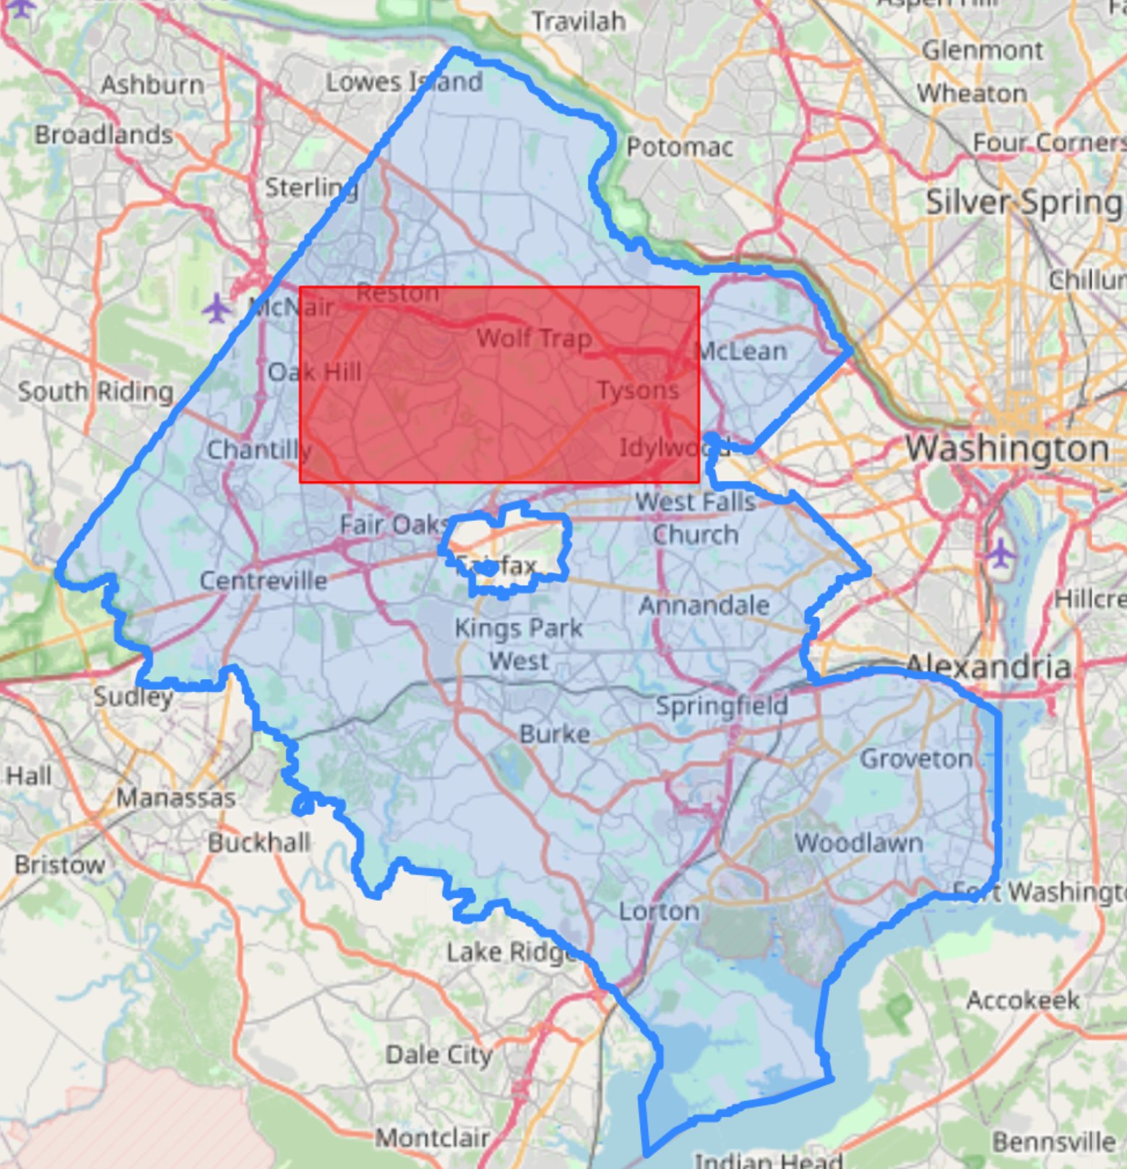
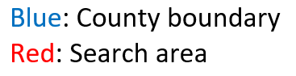
Analysis: Mapping Fairfax County and the search area

Slide 7
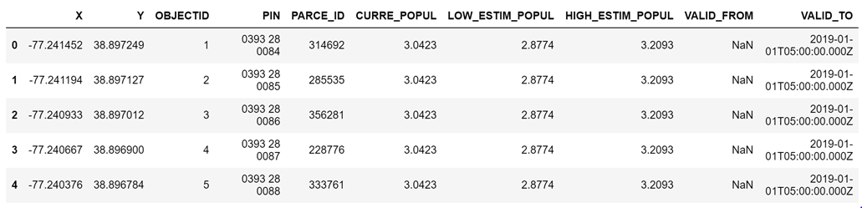
Analysis: Acquiring and cleaning county population data
The first step in the analysis is to extract the most recent population data in Fairfax County. The population data contains the average population per household along with each household geographic location.

Slide 8
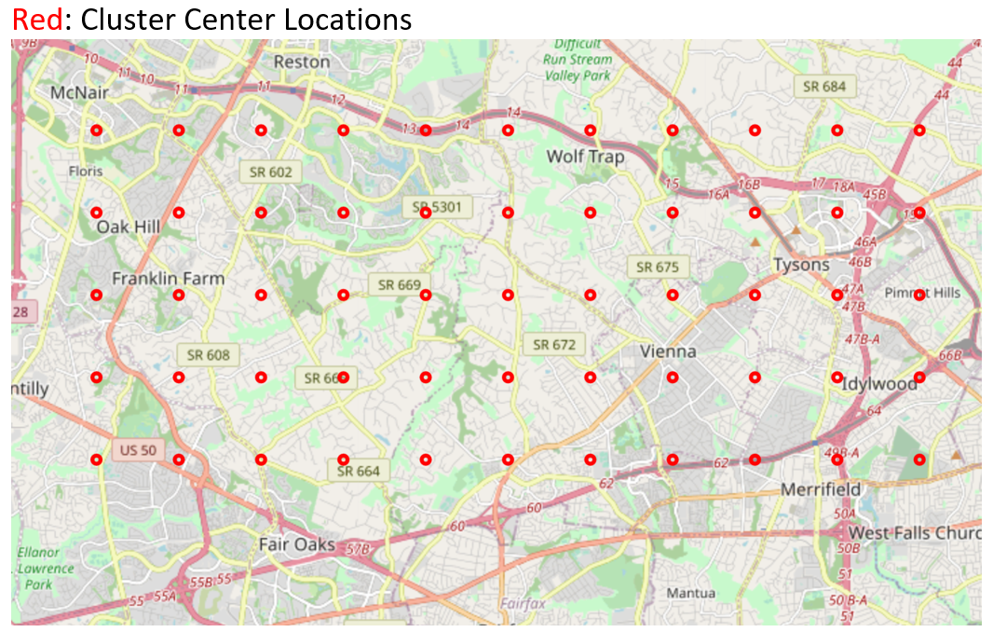
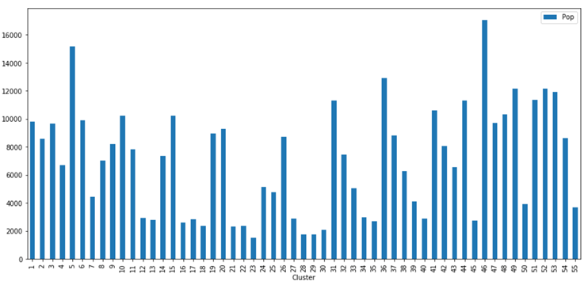
Analysis: Dividing the search area into a grid
The target area polygon is then divided into a grid of equal sized clusters representing sub-neighborhoods. The spacing between the 55 center locations is 2.32 km.
The population count sum of each sub-neighborhood is then computed and assigned to the cluster's centroid location.

Slide 9
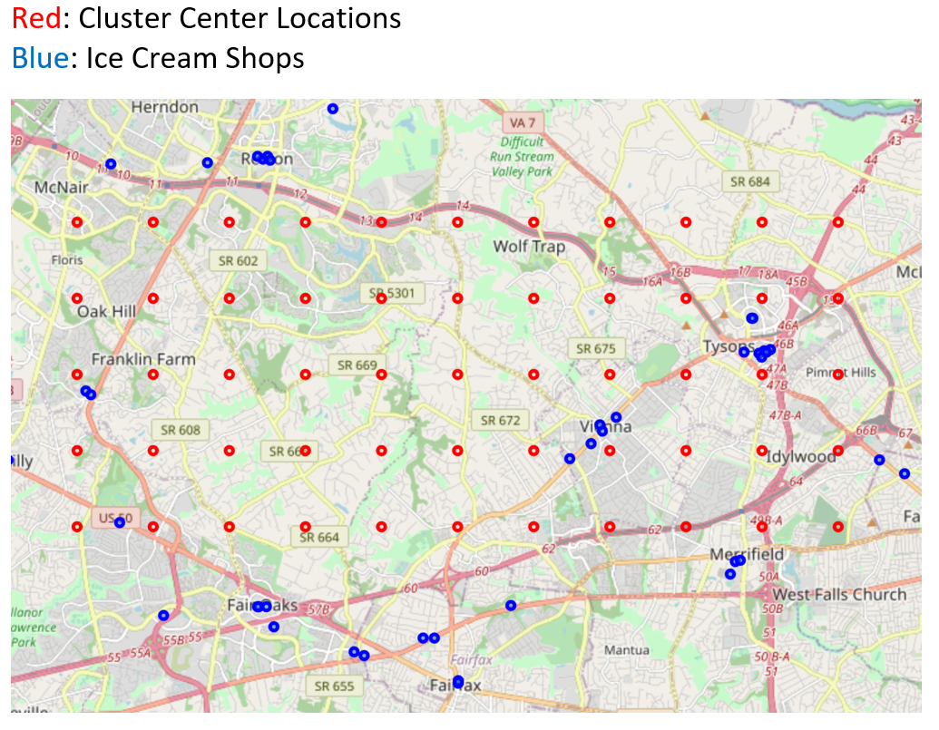
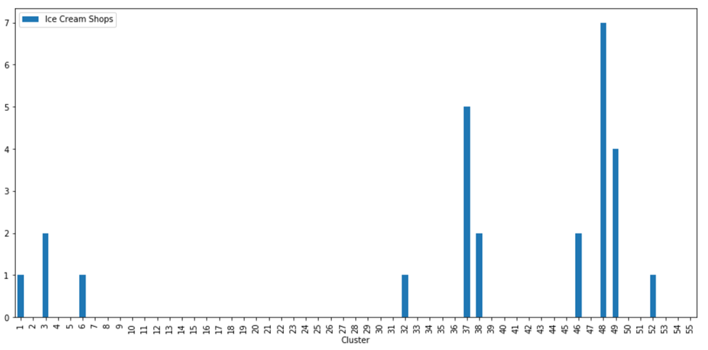
Analysis: Venue Data
Venue data is extracted from the Foursquare location data, reviewed and structured.
There are 67 ice cream shops within 15 kms from the center of the search area.
The Ice Cream Shops within 1275 meters of each centroid are then identified and their counts aggregated.

Slide 10
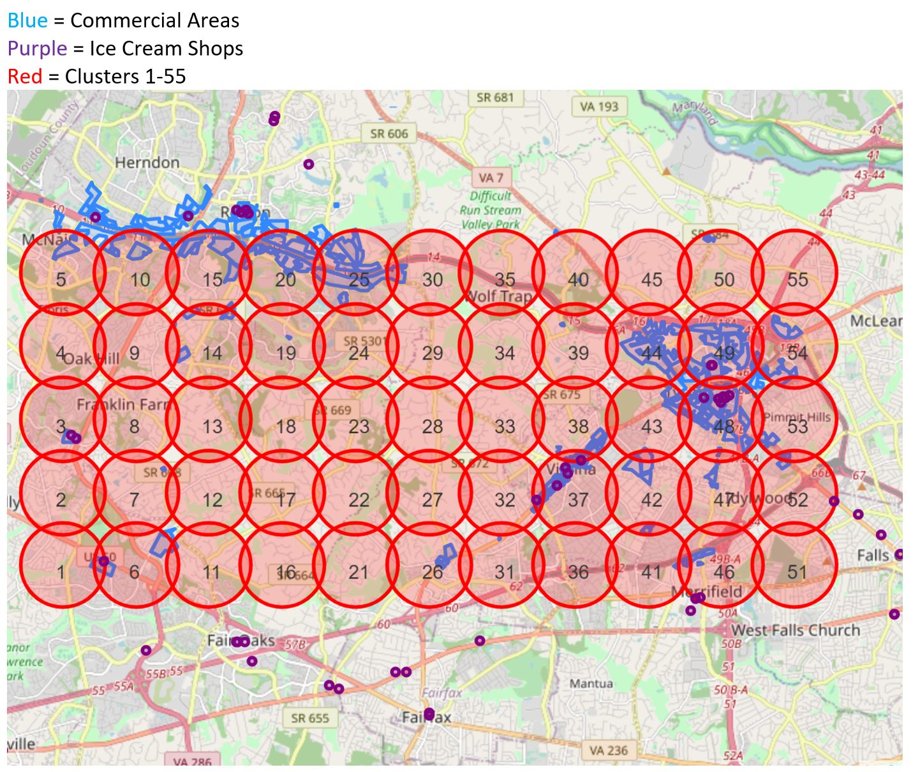
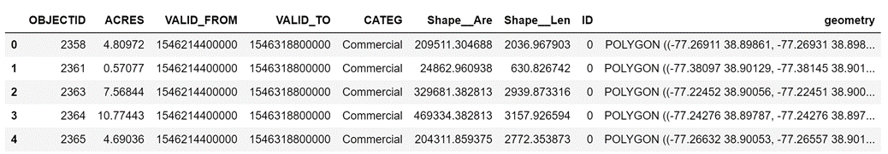
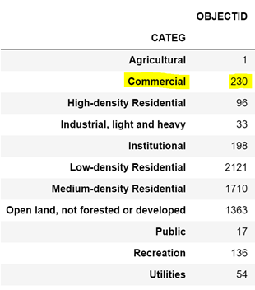
Analysis: County Land-use data
Fairfax County Land-use data is imported, cleaned and mapped to display only commercial areas within the target search area.

Slide 11
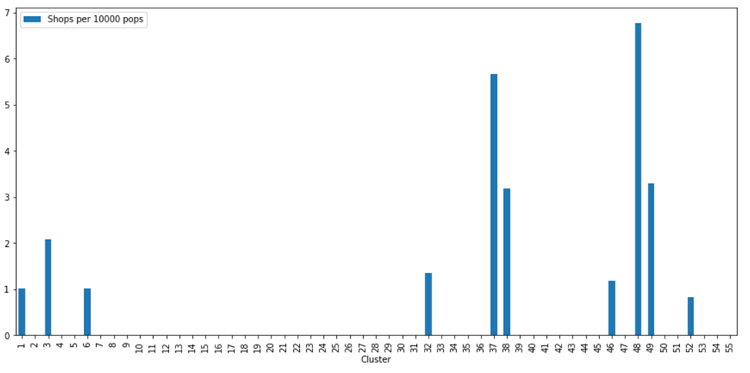
Results and Discussion
The selection is made by process of elimination.
First, clusters without commercial areas are eliminated (23)
Then, clusters with high Ice Cream shops per capita are removed (10)
Finally, 3 locations out of the remaining clusters are selected based on general knowledge of the foot traffic in those clusters.

Slide 12

Conclusion
The best 3 locations for an Ice Cream Shop were identified to be clusters: 5, 44 and 47
Our methodology and final selection will be communicated to the entrepreneur for feedback. Additional study can be conducted as needed based on the feedback received.

Slide 13

Thank You

